Slide 1

Fiscal Services
2015 - 2016
ELTS Workshop

Slide 2

AESOP transfers to ELTS
Employee creates absence in AESOP
Local leave attendant must create VACATION absences
Must be entered into AESOP prior to, or on day of absence
AESOP file with transfer over to ELTS

Slide 3
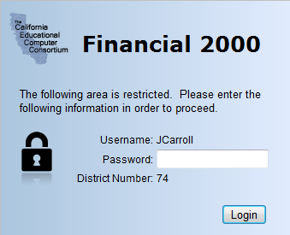
Financial 2000 Business Operating System
Use Internet Explorer. Do not use Chrome.
Make sure the “s” is on the address https://

Slide 4
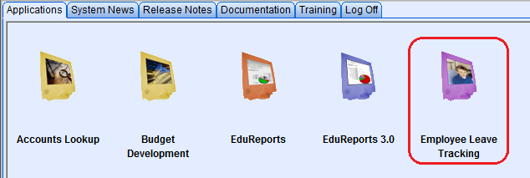
Financial 2000 Business Operating System
ELTS (Employee Leave Tracking System)

Slide 5

Prepare to Print Affidavits
Reconcile attendance report to ELTS
Did all absences transfer over from AESOP to ELTS?
Does your attendance records match up?

Slide 6
Review The Grid Before You Print
Make adjustments if needed
Check leave type
Check hours to be sure they are rounded to the nearest ¼ hour
Add Incident Notes/Transaction Notes

Slide 7
Affidavit New Look

Slide 8
Employees that work at 2 locations
System Configuration – Hours reported to AESOP are uploaded to the primary position first. The balance, if any, is then uploaded to the secondary position.
Full day absences reported in AESOP will transfer to both locations correctly.
Partial day absences reported in AESOP may need to be communicated and adjusted between both sites.

Slide 9
Employees with more than 1 position
System errors can occur when an employee has multiple positions attached to his/her name.
Example: Teacher and Home/Hospital Teacher
Example: Teacher and ROP Teacher
Example: Security Officer and Patrol Officer
Please be aware of employees that may fall under these circumstances.

Slide 10
Family Medical Leave Act (FMLA)
Site/Department receives FMLA/CFRA letter from Personnel.
Note whether FMLA/CFRA was approved for the employee or his/her family member and the duration of time approved.
Note what leave type(s) the employee is allowed to use (sick, family illness, PN, vacation, etc.)
Employee must enter their absence into AESOP with the exception of vacation (local leave attendant must enter vacation in AESOP).
Employee must notify his/her local leave attendant that his/her absence is FMLA/CFRA approved.
When the absence is transferred over to ELTS, the local leave attendant must add FMLA to the transaction note.
Affidavit is then printed with the transaction note FMLA for the employee to sign.

Slide 11
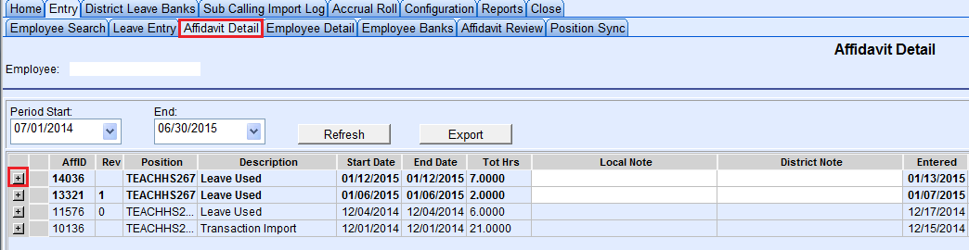
FMLA Transaction Note
Click on Affidavit Detail, then click on the + sign to expand the date of absence.

Slide 12
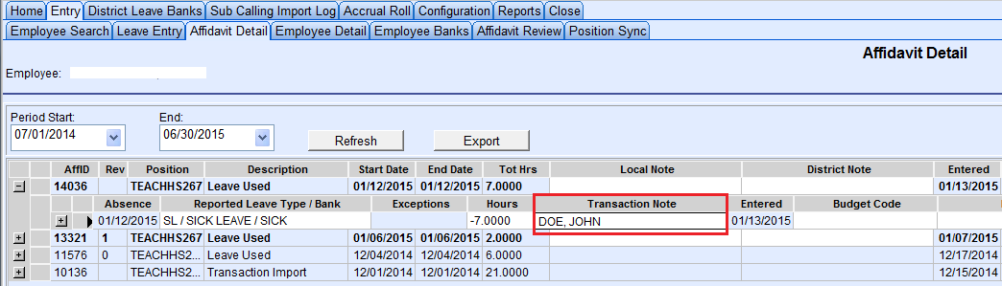
FMLA Transaction Note
Click on Transaction Note.

Slide 13
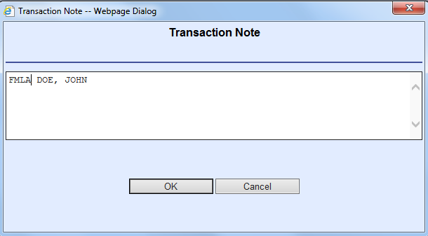
FMLA Transaction Note
Insert FMLA in front of Substitute Name

Slide 14
Bereavement Incident Note
Incident notes are used to count the number of days for a specific incident.
Bereavement is the only leave type that requires an incident note. Effective 2015-2016, Industrial Injury leave type does NOT require an incident note.
On the Leave Entry Screen, double click on B3/B5. Or, on the Affidavit Detail Screen, click on the affidavit.

Slide 15
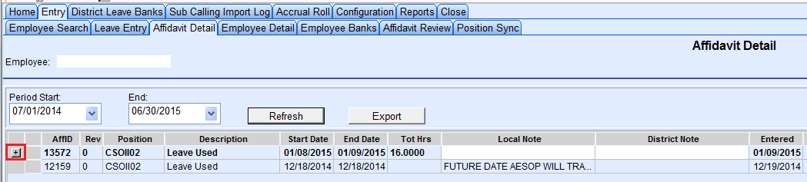
Bereavement Incident Note
Click on the + sign to expand the date of absence.

Slide 16
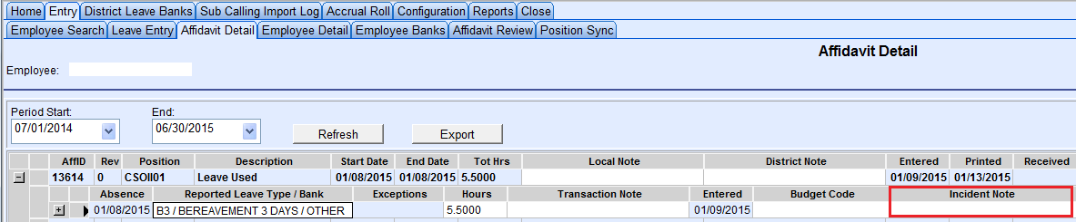
Bereavement Incident Note
Click on Incident Note.

Slide 17
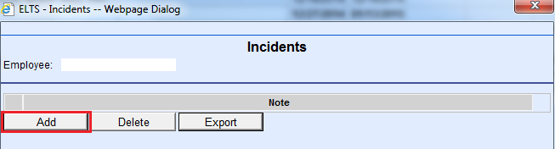
Bereavement Incident Note
Click on Add.

Slide 18
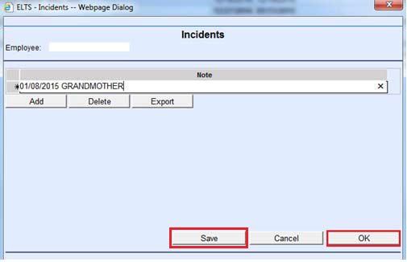
Bereavement Incident Note
Add note as “xx/xx/2015 Relationship” example: “01/08/2015 GRANDMOTHER”
Click on Save to add to Incident log, then click on OK to apply Incident Note.

Slide 19
Bereavement Incident Note
Once an Incident Note has been entered on the Incident Log, it will NEVER need to be added again.
Only “add” the Incident Note to the log ONE TIME. YOU SHOULD NEVER HAVE DUPLICATED ENTRIES.
ADD = Create new note to log OK = Apply note to absence

Slide 20

Wrong Bereavement Incident Notes
03/30/2015 BROTHER PASSED | B3-01/09/2015 | MOTHER IN LAW PASSED AWAY
04/22/2015 UNCLE | BEREAVEMENT 3 DAY/AUNT | MOTHER-IN-LAW
04/22/2015 UNCLE 2ND DAY | BEREAVEMENT-UNCLE | MOTHER-IN-LAW PASSED AWAY
05/08/2015 BEREAVEMENT MOTHER | BEREVEMENT - FATHER | OUT OF STATE; GRANDMOTHER, 02/12/15
06/16/15, BROTHER | BROTHER | OUT OF STATE; GRANDMOTHER, 03/07/2015
1/22 GRANDFATHER | BROTHER IN LAW | RELATIONSHIP, GRANDMOTHER
1/22/15 - G-FATHER | BROTHER IN LAW - 12/25/14 | SISTER-IN-LAW
12/29/14 BROTHER | BROTHER IN LAW; BROTHER IN LAW | UNCLE
12/29/2014 BROTHER | BROTHER PASSED 5-5-2015 | UNCLE 01/12/2015
2/5/15 - GRANDFATHER-IN-LAW (WIFE'S GRANDFATHER) | DEATH OF UNCLE OUT OF STATE AZ | UNCLE, 02/10/2015
3 DAY BEREAVEMENT/AUNT | FATHER DIED | UNCLE, 02/16/2015
3 DAY BEREAVEMENT/UNCLE | FATHER IN LAW | UNCLE, 4/20
3/30-3/31/15 MOM | FATHER IN LAW PASSED AWAY | UNCLE, 4/28/2015
4/13-4/20- FATHER PASSED AWAY | GRANDMOTHER | WIFE'S GRANDMOTHER
4/1-4/3 UNCLE PASSED AWAY | GRANDMOTHER, 02/12/15
AUNT | GRANDMOTHER, 03/07/2015
AUNT 04/09/2015 | HUSBAND
AUNT 2/23/2015 | HUSBAND - 4/13/15
AUNT 6/27/15 | MOTHER
AUNT, 03/01/2015 | MOTHER IN LAW 01/15/2015
AUNT, 2/10/2015 | MOTHER IN LAW 01/20/2015

Slide 21
What’s the big fuss about AFFIDAVITS?
Affidavits MUST be turned in weekly!
AESOP does not feed into the payroll system automatically. Absences will not be properly recorded without a completed and signed Affidavit.

Slide 22
In the event of long term absences
(Off-Work Orders, Industrial Injury, and Maternity Leave), affidavits are to be completed immediately and sent to Payroll, noting “Signature Unavailable” on the Employee Signature line.

Slide 23
A delay in Affidavit processing can result in salary overpayment. NOTE: Classified employees are paid current; therefore overpayments may happen very easily if communication is not present. Let’s work together to prevent these situations.

Slide 24

PAYROLL
FREQUENTLY ASKED QUESTIONS
When is an affidavit required?
Whenever an employee is absent from work other than for school business. (Example: Maternity Leave, FMLA, Worker’s Compensation, CFRA, etc.)
If an employee has called into the AESOP system, does an affidavit still need to be submitted?
Yes. AESOP does not feed into the Payroll system.
How often should affidavits be sent up to Payroll?
Weekly

Slide 25
How many Family Illness, Personal Necessity, and General Leave days are employees entitled to use per fiscal year?
 | Certificated | Classified
 | Days per Fiscal Year | Days per Fiscal Year
Family Illness | 6 | 6
Personal Necessity | 8 | 7
General Leave | 2 | 0
If an employee leaves work early because their child is ill, is “FMLA” an acceptable reason to list on an affidavit?
No. “FMLA” stands for Family Medical Leave Act and must be requested and approved through Personnel.

Slide 26
If an employee needs to change an affidavit that has already
been submitted to Payroll, what should the employee do?
  Obtain a copy of his/her original affidavit
  Make changes as needed
  Write “Revised” on the top of the affidavit
  Submit to his/her administrator for approval
  Forward to Payroll for change(s) to be made
Will Payroll accept an affidavit without an employee’s signature?
  Yes, when the dates are covered by an acceptable doctor’s off work order (including Industrial Injury) and when an employee has been absent for an extended period.
  “Signature Unavailable” must be written on the “Signature of Employee” line.

Slide 27
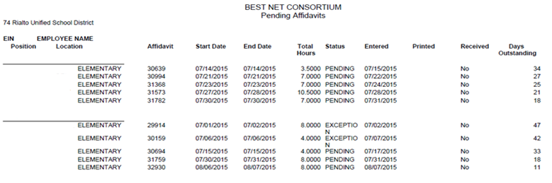
Employee Monthly Report
Attach all affidavits listed on your report, sign by admin, and submit to Payroll by the 15th of each month.

Slide 29

ANY QUESTIONS?

